Slide 1
Compressing Arrays by Ordering Attribute Values
Owen Kaser
Computer Science and Applied Statistics, University of New Brunswick, Saint John, Canada
Information Processing Letters 92 (2004) 253–256
Presenter: Mao-Yuan Kao
Date: May 18, 2006

Slide 2

Normalization
Normalizes dimensional attributes by mapping
attribute values to integers.
E.g.,if D1 = {Red,White}, one might map Red to 1
and White to 2, or vice versa.
In general, the mapping σ_{i} of the ith attribute is a
bijection from Di to {1, 2, . . ., |Di |}.

Slide 3
Sparse array and Dense array
Consider the tuple (m, v₁, v₂, . . . ,v_{k}) ∈ R.
We can treat each of the k attributes as a dimension of a
multidimensional array A;
attribute relation R⊆ R×D₁×D₂×···×D_{k} commonly involves a
k-dimensional array,
the integer values σ₁(v₁), . . . ,σ_{k}(v_{k}) provide an index into
A, and the measure value m is stored as
A[σ₁ (v₁),σ₂(v₂), . . . ,σ_{n}(v_{k})].

Slide 4
Sparse array and Dense array (cont.)
Some of the indices within the array do not correspond to
any tuple of the relation;
these store a flag indicating “no measure value”.
The array is sparse if there are far fewer measure values
than flagged values; otherwise the array is dense.

Slide 5
Chunked
Large multidimensional arrays are often broken into chunks for storage
and processing. Consider some normalized k-dimensional array A,
whose dimensionality is |D₁| × |D₂|×···×|D_{k} |.Chunks can be formed by
breaking each D_{i} into several ranges.
In memory or on disk, values within a chunk are stored consecutively,
in some order. Also, the dense/sparse classification can be extended to
chunks in the obvious manner. Therefore, an arraymay be represented
as a mixture of sparse and dense chunks, but since there is some per-
chunk storage overhead, we do not want too many chunks.
Normalization and Chunking interact to affect chunk density.

Slide 6
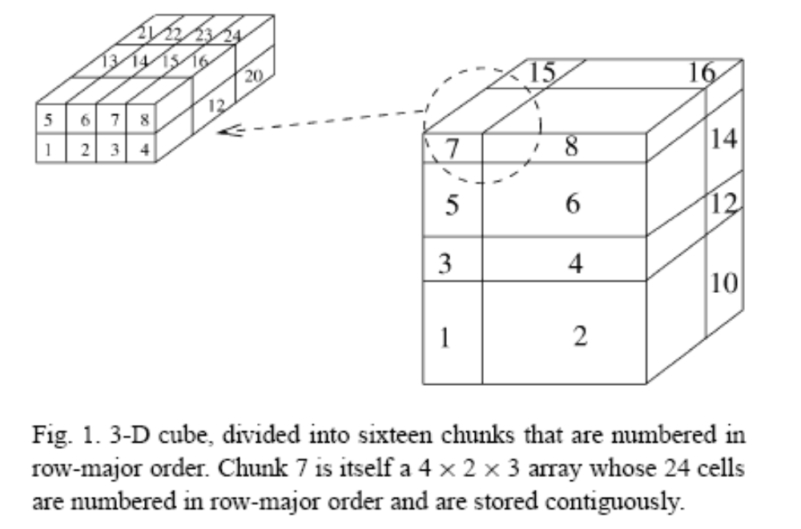
Chunked arrays

Slide 7
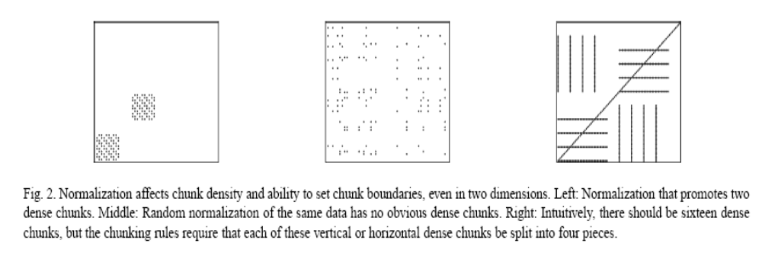
Chunked arrays (cont.)

Slide 8
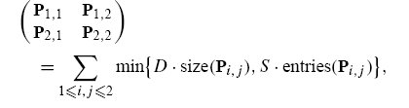
2-D 4-chunk compression (2D4C)
Given a 0/1 matrix P and positive integers B, D, S, can the rows and
then the columns of P be permuted, and then divided into 4 (= 2 × 2)
chunks, such that the storage cost is at most B? The storage cost of
D is the cost of storing a (possibly empty) index within the dense chunk
S is the cost of storing a nonempty index within a sparse chunk.
size(M) = xy if matrix M is of order y×x and
entries(M) denotes the number of ones in M.

Slide 9
Maximum Edge Biclique (MEB)
Given a bipartite graph G = (V₀,V₁,E) and a positive integer K, are
there two subsets V₀’ ⊆ V₀ and V₁’ ⊆ V₁ such that |V₀’| · |V₁’| ≧K and
such that v ∈ V₀ ’ and w ∈ V₁ ’ implies that (v,w) ∈ E?
biclique is a complete bipartite graph; the problem asks whether a
given bipartite graph contains a biclique with many edges.

Slide 10
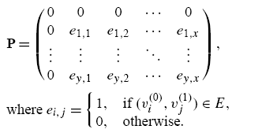
2D4C is NP-Complete
Given an instance of MEB, form an instance of 2D4C by adjoining the
bipartite adjacency matrix of G to an all-zero row and to an all-zero
column. Specifically, number the vertices of V₀ arbitrarily as
v₁ ⁽⁰⁾ , v₂ ⁽⁰⁾, . . . , v_{y} ⁽⁰⁾ and number the vertices of V1 arbitrarily as
v₁ ⁽¹⁾ , v₂ ⁽¹⁾ , . . . , v_{x} ⁽¹⁾ .
Then form the matrix P, whose rows correspond to vertices in V₀ and
whose columns correspond to vertices in V₁.
Set D to 2|E|
Set S to 1 + D
Set B to K ·D + (|E| − K) ·S

Slide 11
2D4C is NP-Complete (cont.)
(MEB=>2D4C)
Permute the rows of P so the rows corresponding to vertices in V₀’ are
topmost. Permute the columns, so that columns corresponding to
vertices in V₁ ’ are leftmost.
The submatrix P_{1,1} is entirely ones, because of the biclique in MEB.
It contains K ‘> K ones, and thus the remaining three submatrices
contain |E| −K ones. Therefore, the storage cost is at most B.

Slide 12
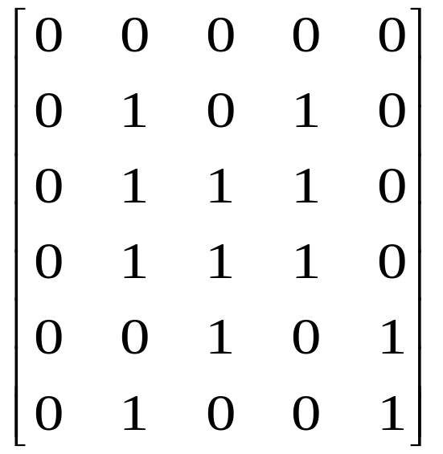
MEB=>2D4C (cont.)
a1
a2
a3
a4
a5
b1
b2
b3
b4
a1
a2
a3
a4
b1
b2
b3
b4
a5
K = 5
B’ <= B?

Slide 13
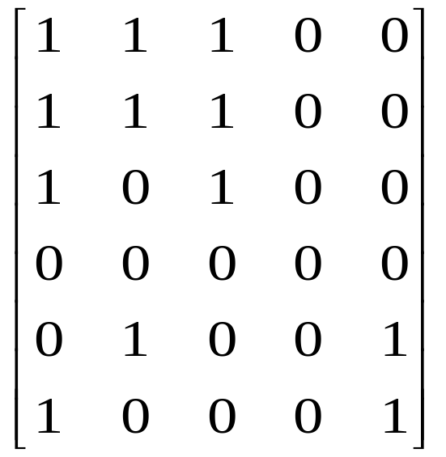
MEB=>2D4C (cont.)
b1
b2
b3
b4
b1
b2
b3
b4
a2
a1
a3
a2
a1
a3
a4
a4
a5
a5
D = 2 |E|, S = D+1
B = K*D + ( |E| - K) * S
K = 5 ( k’=6 > k )
B’= K’*D + (|E| - K’) * S
= 6*D+6*S < 5*D+7*S
=> B’ < B
a1
a2
a3
a4
a5
b1
b2
b3
b4

Slide 14
2D4C => MEB
Meeting bound B implies storing at least K ones in completely dense
chunks: since S >D there cannot be more than |E| −K stored themore
expensive way. Thus, there is at least one dense chunk; suppose that
P_{1,1} is dense. Also, P_{1,1} is completely dense: it contains no zeros.
A completely dense chunk corresponds to a biclique; thus, the instance
of MEB has at least K edges belonging to bicliques.
It remains to show that there is only one biclique, but this is enforced by
the column and row of zeros adjoined to P.
No matter how columns and rows are permuted, at most one chunk
(P_{1,1}) can be completely dense. Therefore, from P_{1,1} we can find a
biclique with at least K edges in the instance of MEB.

Slide 15
2D4C => MEB (cont.)
b1
b2
b3
b4
a1
a2
a3
a4
a5
a1
a2
a3
a4
a5
b1
b2
b3
b4
|V0’| · |V1’| ≧K
K=5 (是否成立??)

Slide 16
2D4C => MEB (cont.)
b1
b2
b3
b4
b1
b2
b3
b4
a2
a1
a3
a2
a1
a3
a4
a4
a5
a5
D = 2 |E|
S = D+1
B = K*D + ( |E| - K) * S
K = 5
B’< B → K’> K
a1
a2
a3
a4
a5
b1
b2
b3
b4

